Slide 1
STEM (Spatio-temporal Epidemiological Modeler)
Katherine Sweeney, Ashanti Long, Clare Clever

Slide 2
What is STEM?
Notes:
The Spatio-temporal Epidemiological Modeler, or (STEM) for short is a graph based spatio-temporal simulation engine. It allows researchers to produce models on infectious diseases. Such models can provide a plethora of information. All of this data can assist scientists in learning more about specific diseases. Such pieces of information could include infection rates, potentially allowing for the ability to mitigate or even prevent infection. It addition, the STEM application allows for models to be made consisting of climate data.

Slide 3
What is STEM?
The Spatio-temporal Epidemiological Modeler, or (STEM) for short is a graph based spatio-temporal simulation engine. It allows researchers to produce models on infectious diseases. Such models can provide a plethora of information. All of this data can assist scientists in learning more about specific diseases. Such pieces of information could include infection rates, potentially allowing for the ability to mitigate or even prevent infection. It addition, the STEM application allows for models to be made consisting of climate data.

Slide 4
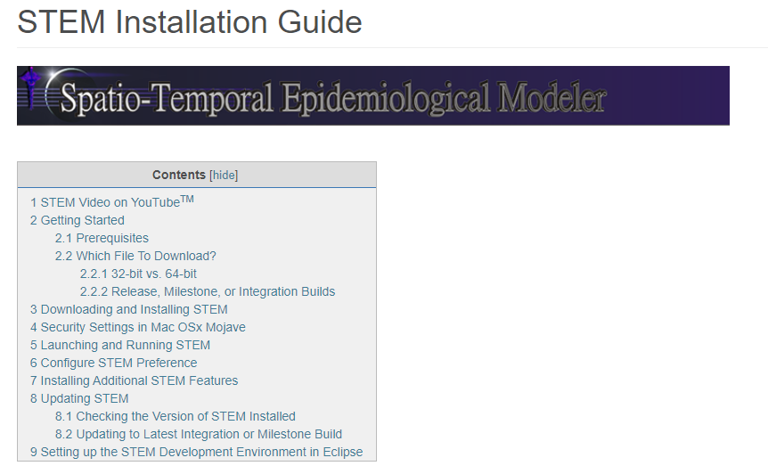
Why We Chose STEM
Notes:
We choose to work with the STEM application because of its extensive documentation. The provided documentation surrounded all aspects of the application, from building it, to constructing models. This solidified our choice in selecting this project. Additionally, the actual project itself is pretty interesting.

Slide 5
Why We Chose STEM
We choose to work with the STEM application because of its extensive documentation. The provided documentation surrounded all aspects of the application, from building it, to constructing models. This solidified our choice in selecting this project. Additionally, the actual project itself is pretty interesting.

Slide 6
Method Selection
Notes:
The STEM engine manipulates data taken as input to produce spatio-temporal models. The program contains a plethora of mathematical functions that are needed to compute the related statistical values used for the modeling. Most of the methods that we were interested in testing were related to mathematical functions.

Slide 7
Method Selection
The STEM engine manipulates data taken as input to produce spatio-temporal models. The program contains a plethora of mathematical functions that are needed to compute the related statistical values used for the modeling. Most of the methods that we were interested in testing were related to mathematical functions.

Slide 8
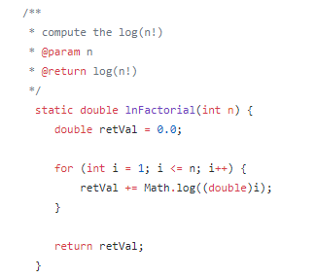
lnFactorial()

Slide 9
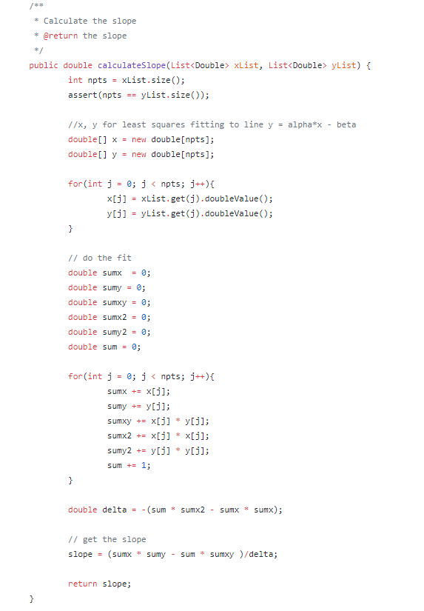
calculateSlope()

Slide 10
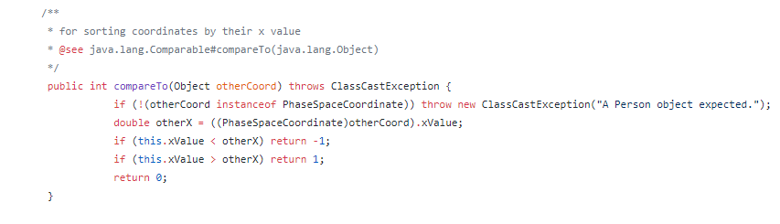
compareTo()

Slide 11
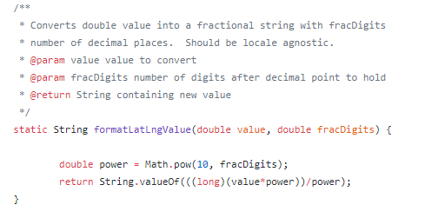
formatLatLngValue()

Slide 12
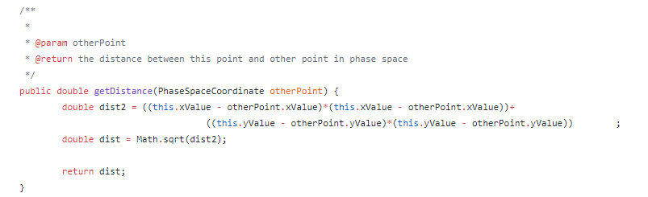
getDistance()

Slide 13
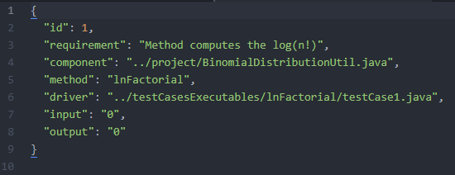
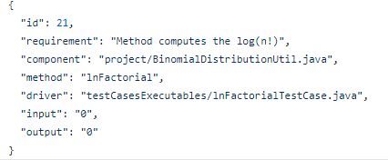
Test Case Progression
Initial
Final

Slide 14
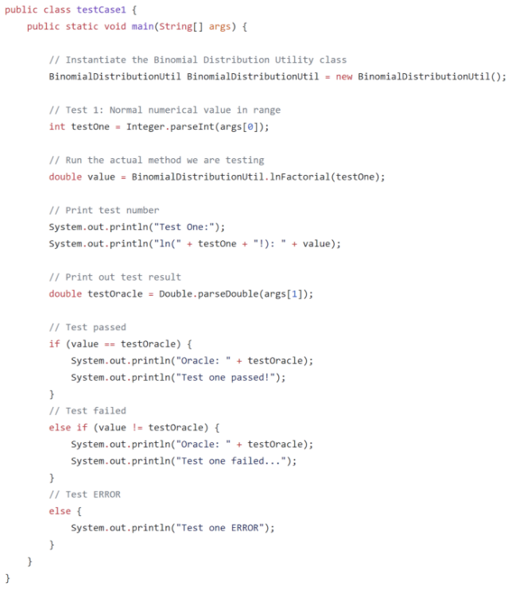
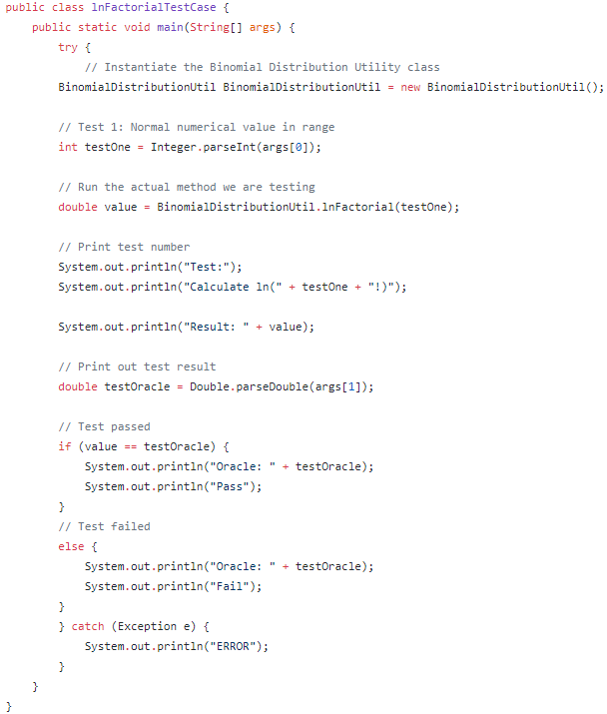
Bad Driver
Improved Driver
Notes:
Try-catches added as to not cause spontaneous combustion given unacceptable input. Drivers are generalized for method instead of individual test cases.

Slide 15
Bad Driver
Improved Driver
Try-catches added as to not cause spontaneous combustion given unacceptable input. Drivers are generalized for method instead of individual test cases.

Slide 16
Script Mistakes
Notes:
Our initial script hardcoded the test cases. This is bad. We then approached the problem from the perspective of the methods, instead of the test cases, so we were preloading the method names and building the script around the methods. Luckily, we were able to take the fundamentals of how our script ran and use that to implement the testing framework correctly.
The only potential problem with the way our script runs, is that it preloads the test cases. This means that if there were significantly more test cases, the script would be slow. However, for the scope of the project we found that this was the easiest approach.

Slide 17
Script Mistakes
Our initial script hardcoded the test cases. This is bad. We then approached the problem from the perspective of the methods, instead of the test cases, so we were preloading the method names and building the script around the methods. Luckily, we were able to take the fundamentals of how our script ran and use that to implement the testing framework correctly.
The only potential problem with the way our script runs, is that it preloads the test cases. This means that if there were significantly more test cases, the script would be slow. However, for the scope of the project we found that this was the easiest approach.

Slide 18
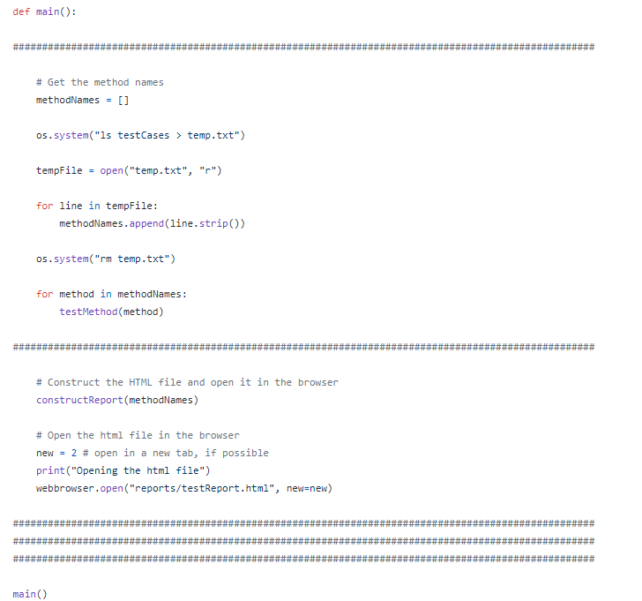
Incorrect Script Attempt

Slide 19
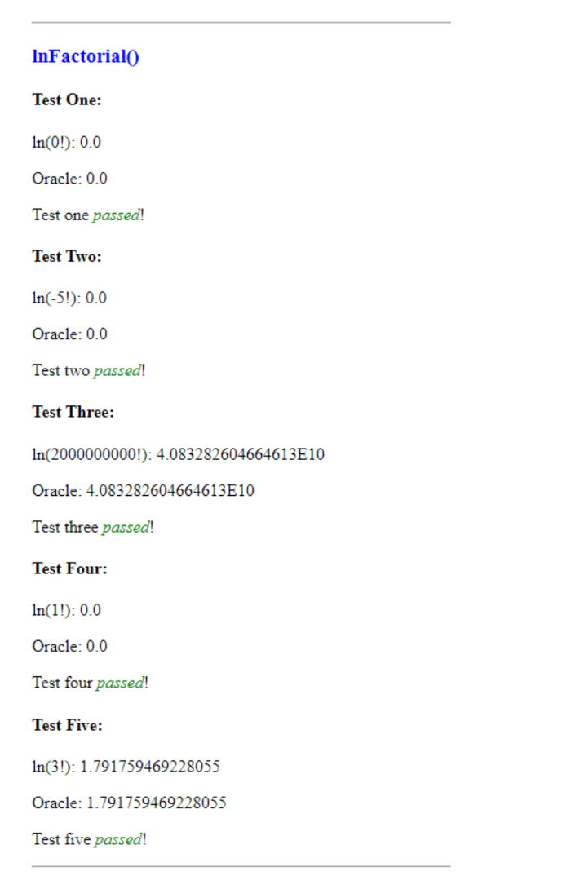
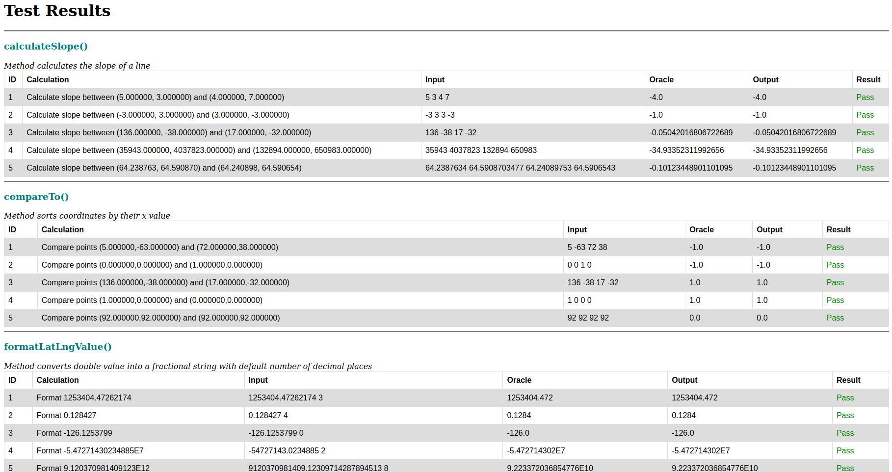
Test Result Report Progression

Slide 20
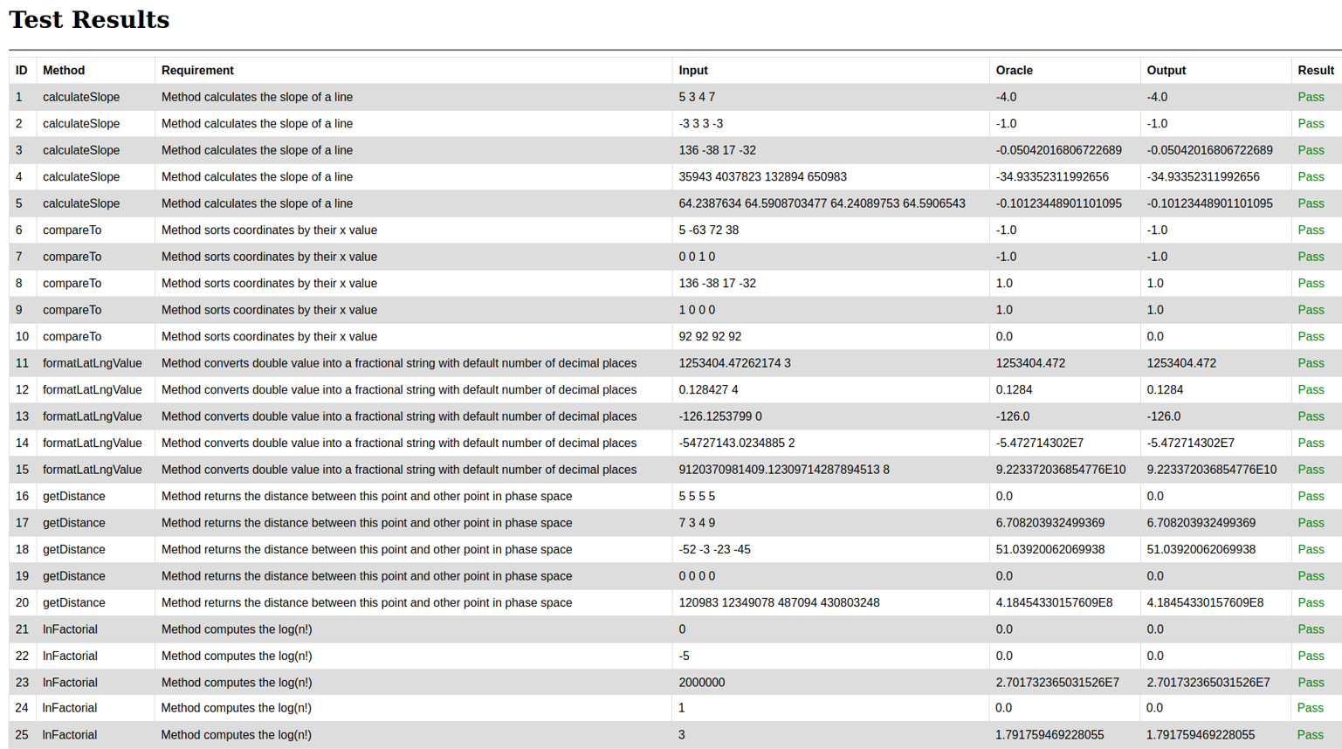
Final Test Results Report
Notes:
The cleaned up test result report was incorrect because of the nature of how the script was executing. Unfortunately, we were not able to find a good way to sort them by the methods, so we ended up sorting the test case results in ascending order by their respective ID. The report is grouped by the method name due to how the test cases are grouped within their folder. If new test cases were added, it wouldn’t necessarily mean the test cases would be grouped by method name.

Slide 21
Final Test Result Output Explanation
The cleaned up test result report was incorrect because of the nature of how the script was executing. Unfortunately, we were not able to find a good way to sort them by the methods, so we ended up sorting the test case results in ascending order by their respective ID. The report is grouped by the method name due to how the test cases are grouped within their folder. If new test cases were added, it wouldn’t necessarily mean the test cases would be grouped by method name.

Slide 22
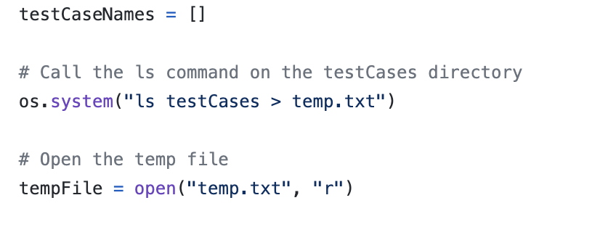
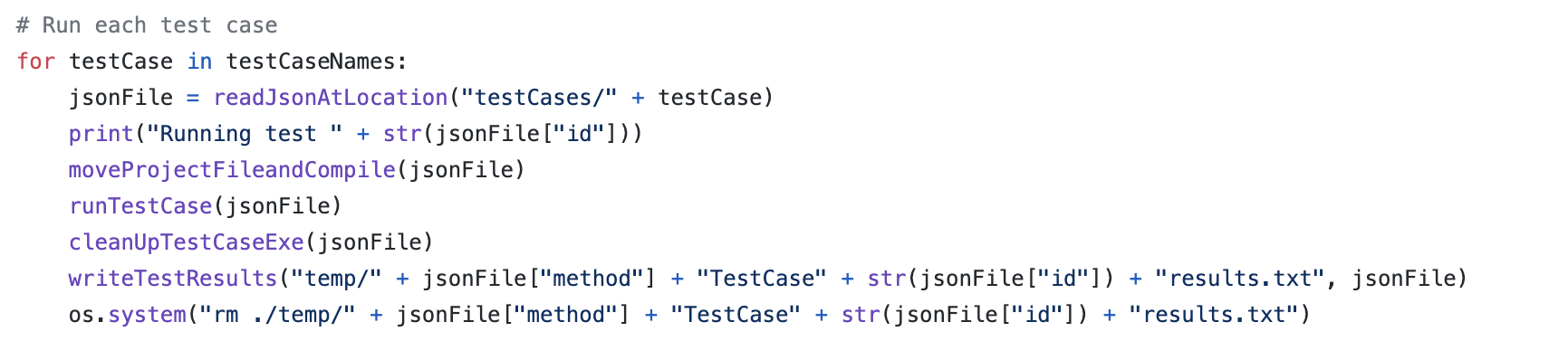
Final Script Implementation (Main)

Slide 23
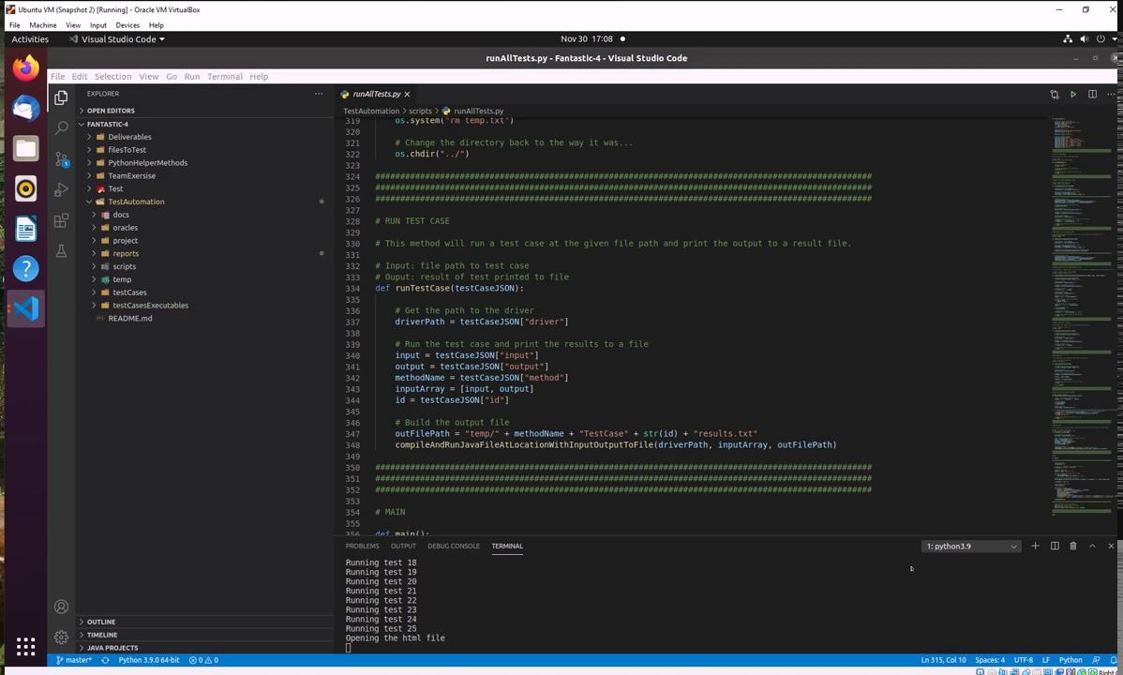
Script Demo

Slide 24
Faults
Notes:
We scrutinized the methods to come up with realistic mistakes/faults that someone could possibly make during implementation. We used a boolean variable to implement the faults, so that if it is set to true, then the faulted code will execute, otherwise, the original code will execute.

Slide 25
Faults
We scrutinized the methods to come up with realistic mistakes/faults that someone could possibly make during implementation. We used a boolean variable to implement the faults, so that if it is set to true, then the faulted code will execute, otherwise, the original code will execute.

Slide 26
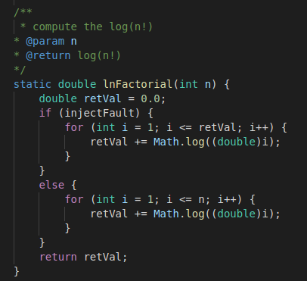
lnFactorial()
Notes:
For this fault, we changed how many times the for loop would iterate for computing the log(n!). We thought it might be possible for someone to make a mistake and set the for loop to run retVal times, instead of n times. This passed three test cases, and failed two. It passed the test cases where the value passed in as input was -5, 0, and 1.

Slide 27
lnFactorial()
For this fault, we changed how many times the for loop would iterate for computing the log(n!). We thought it might be possible for someone to make a mistake and set the for loop to run retVal times, instead of n times. This passed three test cases, and failed two. It passed the test cases where the value passed in as input was -5, 0, and 1.

Slide 28
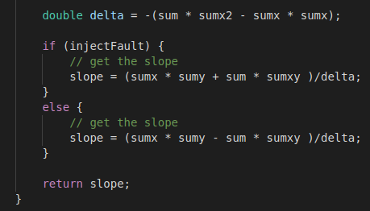
calculateSlope()
Notes:
For this fault, we used subtraction where there was supposed to be addition. It failed all test cases. We could not think of a change that would result in some test cases passing. We had to decide on a fault that could be realistic, not break the code, but unfortunately fail all test cases.

Slide 29
calculateSlope()
For this fault, we used subtraction where there was supposed to be addition. It failed all test cases. We could not think of a change that would result in some test cases passing. We had to decide on a fault that could be realistic, not break the code, but unfortunately fail all test cases.

Slide 30
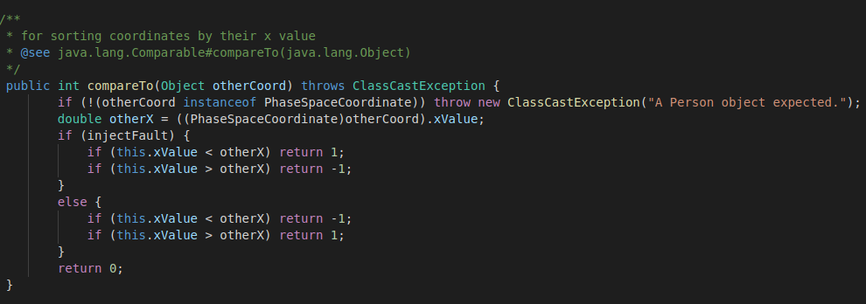
compareTo()
Notes:
Here we decided that it could be possible for someone to accidentally switch the proper return values for the conditionals. This failed all test cases besides one, where the input points were the same.

Slide 31
compareTo()
Here we decided that it could be possible for someone to accidentally switch the proper return values for the conditionals. This failed all test cases besides one, where the input points were the same.

Slide 32
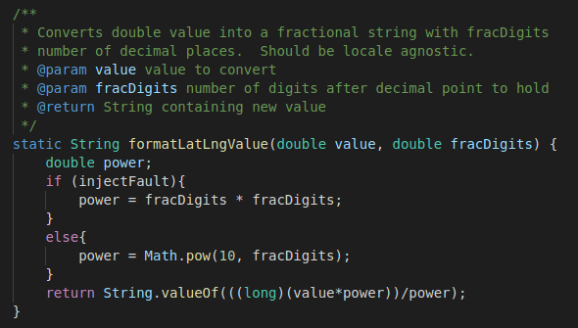
formatLatLngValue()
Notes:
For this method, we could not think of something that would pass some of the test cases. We decided that someone could make a mistake when formatting the number of decimal places by computing the power as fracDigits * fracDigits, instead of taking 10^fracDigits.

Slide 33
formatLatLngValue()
For this method, we could not think of something that would pass some of the test cases. We decided that someone could make a mistake when formatting the number of decimal places by computing the power as fracDigits * fracDigits, instead of taking 10^fracDigits.

Slide 34
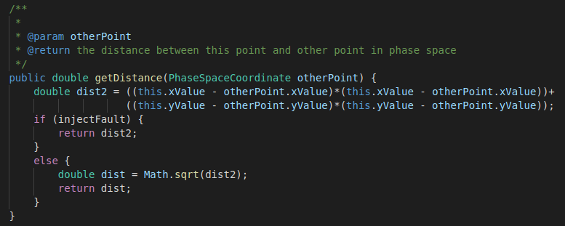
getDistance()
Notes:
When considering what could go wrong with implementing the Euclidean distance formula, we thought that it might be realistic for someone to compute the ‘inside’ of the distance formula, and then after computing it return that value, instead of taking the square root of the computed value. This fault resulted in failing 3/5 of the test cases. The two test cases that passed were when the points were all the same, or they were all 0.

Slide 35
getDistance()
When considering what could go wrong with implementing the Euclidean distance formula, we thought that it might be realistic for someone to compute the ‘inside’ of the distance formula, and then after computing it return that value, instead of taking the square root of the computed value. This fault resulted in failing 3/5 of the test cases. The two test cases that passed were when the points were all the same, or they were all 0.

Slide 36
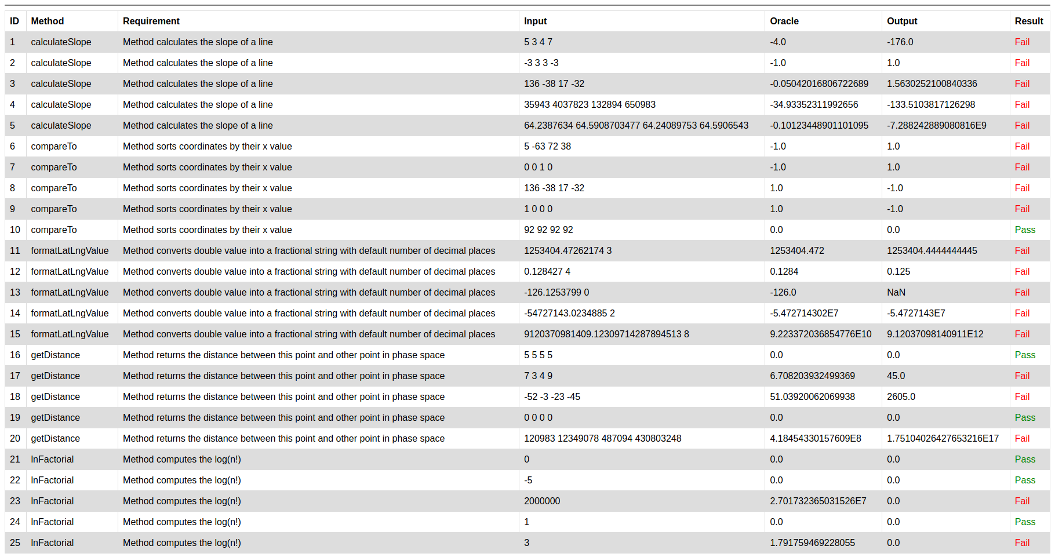
Test Result Report with Faults Live

Slide 37
Reflections on Fault Injection
Notes:
We found that it was crucial to fully test each method. Faults can exist that are not going to cause errors to be thrown but could cause the method to behave in a way that it is not supposed to. This project demonstrated the importance of double-checking things. Additionally, we learned how to implement test cases to catch potential logic errors. Subsequently shining a light on the idea that errors are not going to be caught by the compiler 100% of the time. Logic errors need to be found via exhaustive testing, or through additional human scrutinization of the code.

Slide 38
Reflections on Fault Injection
We found that it was crucial to fully test each method. Faults can exist that are not going to cause errors to be thrown but could cause the method to behave in a way that it is not supposed to. This project demonstrated the importance of double-checking things. Additionally, we learned how to implement test cases to catch potential logic errors. Subsequently shining a light on the idea that errors are not going to be caught by the compiler 100% of the time. Logic errors need to be found via exhaustive testing, or through additional human scrutinization of the code.

Slide 39
Closing Thoughts
Notes:
At the beginning of the semester, this project seemed insurmountable. Between the lack of experience with GitHub, scripts, and overall naivete, the prospect of tackling this project was daunting. In addition to the unfamiliar territory we were entering, our team consisted of a group of people who had no prior experience with each other. As was stressed again and again throughout the course, planning is everything. Planning requires communication, and overall team cohesion. So not only did this project introduce us to new aspects of computer science, we were also introduced to an environment in which we needed to adapt, and maintain proper communication in order to reach our milestones, and ultimately to deliver a successful project. Luckily, communication was not lacking. While we made several mistakes along the way, we were able to fix them, even though it took more than one try, due to all team members’ willingness to provide solutions and ideas to resolve problems. Every mistake was a team mistake, and every resolution was arrived at due to team effort.

Slide 40
Closing Thoughts
At the beginning of the semester, this project seemed insurmountable. Between the lack of experience with GitHub, scripts, and overall naivete, the prospect of tackling this project was daunting. In addition to the unfamiliar territory we were entering, our team consisted of a group of people who had no prior experience with each other. As was stressed again and again throughout the course, planning is everything. Planning requires communication, and overall team cohesion. So not only did this project introduce us to new aspects of computer science, we were also introduced to an environment in which we needed to adapt, and maintain proper communication in order to reach our milestones, and ultimately to deliver a successful project. Luckily, communication was not lacking. While we made several mistakes along the way, we were able to fix them, even though it took more than one try, due to all team members’ willingness to provide solutions and ideas to resolve problems. Every mistake was a team mistake, and every resolution was arrived at due to team effort.

Slide 41
Questions? Comments?

